Slide 1
Hearing
Hearing is the ability to perceive sound.
The ear is an engineering marvel because its sensory receptors can transduce sound vibrations with amplitudes as small as the diameter of a gold atom (0.3 nm) into electrical signals.
In the ear, mechanical energy is converted into electrical signals.
The signals are 1000 times faster than photoreceptors can respond to light.
The ear also contains receptors for equilibrium.

Slide 2
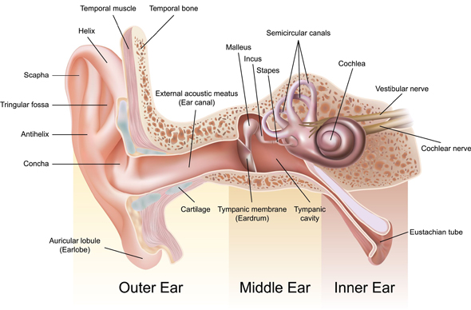
Anatomy of the Ear
The ear is divided into three main regions:
The outer or external ear, which collects sound waves and channels them inward;
The middle ear, which conveys sound vibrations to the oval window;
The inner ear, which houses the receptors for hearing and equilibrium.

Slide 3
Outer ear
The outer ear consists of the auricle, external auditory canal, and eardrum.
The auricle is a flap of elastic cartilage shaped like the flared end of a trumpet and covered by skin.
The rim of the auricle is helix; the inferior portion is the lobule. Ligaments and muscles attach the auricle to the head.
The external auditory canal is a curved tube that extends upto the eardrum. The eardrum is a thin partition between the external canal and the middle ear.
The eardrum is covered by epidermis.
The external canal contains a few hairs and specialized sweat glands (ceruminous glands) that secrete earwax or cerumen.
What are perforated eardrum and impacted cerumen!!!

Slide 4
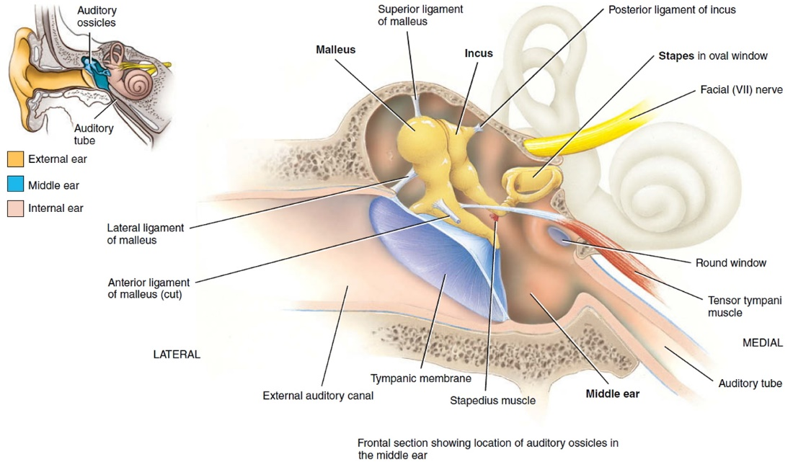
Middle ear
The middle ear is the small air-filled cavity that is lined by the epithelium.
Separated from external ear by eardrum.
Auditory ossicles: malleus, incus and stapes.
The base of the stapes fits into the oval window.
Directly below the oval window is another opening called the round window.
Muscles/ligaments limits movements of ossicles to protect inner ear from loud noises.
Smallest skeletal muscle in human body???

Slide 5
Middle Ear – how it works …
Middle ear works as an amplifier in two ways
Incus
Malleus
Stapes
Area difference
(55 to 3.2 sq mm)
Configuration of ossicles
(Length of malleus and incus)

Slide 6

22 times amplification…
But why??
The cochlea in the inner ear conducts sound through a liquid, instead of through air. This fluid has a much higher inertia than air – i.e., it is harder to move. Hence, more pressure is required.

Slide 7
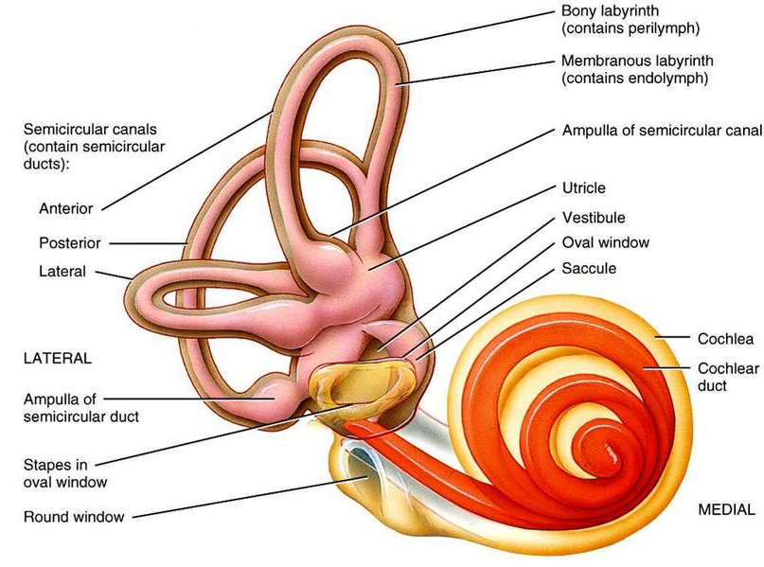
Inner ear
The Inner ear is also called the labyrinth.
Bony labyrinth (BL) and membranous labyrinth (ML).
BL contains perilymph and ML contains endolymph.
The vestibule is the oval central portion of the BL.
Utricle (little bag) and saccule (little sac).
They are connected to the main duct through ampulla (swollen enlargements).
Vestibule houses sensory as well as motor neurons that synapse with receptors for equilibrium.
Anterior to vestibule is cochlea, a bony spiral canal.

Slide 8
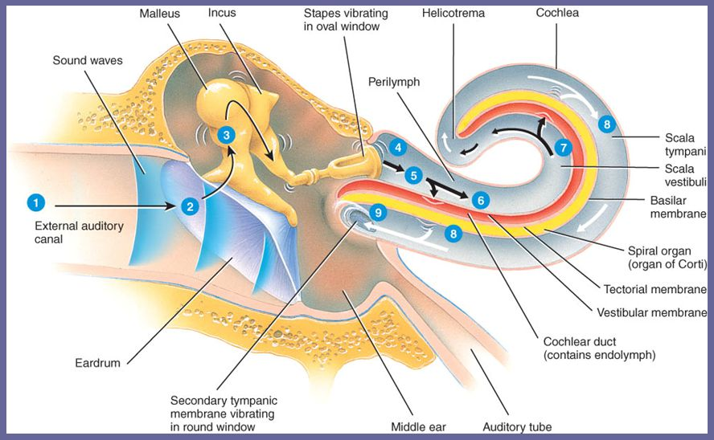
Physiology of hearing

Slide 9
The auricle directs sound waves into the external auditory canal.
When sound waves strike the eardrum, it vibrates back and forth.
The malleus vibrates along with the eardrum, transmitting it further to the incus and then to the stapes.
The stapes moves back and forth and makes the oval window vibrate at an intensity ~22 times more than the eardrum.
This sets up fluid pressure waves in the perilymph of cochlea. As the oval window bulges inward, it pushes on the perilymph of scala vestibuli.
Pressure waves are further transmitted to scala tympani and eventually to the round window, making it to bulge outward into the middle ear.
Pressure waves pushes the vestibular membrane and then move into the endolymph of the cochlear duct.
The pressure in the endolymph causes the basilar membrane to vibrate. Hair cells are perturbed and electrical signal is generated from mechanical vibrations.
Sound waves of various frequencies cause certain regions of the basilar membrane to vibrate more intensely than other regions. Each segment of this membrane is ‘tuned’ for a particular pitch.

Slide 10
